Slide 1
Control Structure/ Iterative /Repetition Structure
By: Nida Munawar

Slide 2
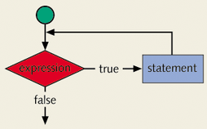
Concept of Looping (Repetition) Structure
One of the basic structured programming concepts
The real power of computers is in their ability to repeat an operation or a series of operations many times
When action is repeated many times, the flow is called a loop

Slide 3
Why Is Repetition Needed?
Suppose we want to add five numbers (say to find their average).
From what you have learned so far, you could proceed as follows.
scanf(%d %d %d %d %d, &num1,&num2,&num3,&num4,&num5);
sum = num1+num2+num3+num4+num5;
average = sum/5;
Suppose we wanted to add and average 100, or 1000, or more numbers.
We would have to declare that many variables, and list them again in scanf statement, and perhaps, again in the output statement.

Slide 4
Repetition
There is two means of repetition
Counter-controlled repetition
Sentinel-controlled repetition
1. Counter-controlled repetition: is sometimes called definite repetition because we know in advance exactly how many times the loop will be executed.
In counter-controlled repetition, a control variable is used to count the number of repetitions. The control variable is incremented (usually by 1) each time the group of instructions is performed. When the value of the control variable indicates that the correct number of repetitions has been performed, the loop terminates and execution continues with the statement after the repetition statement.

Slide 5
Repetition [Cont.]
2. Sentinel-controlled repetition
Sentinel-controlled repetition is sometimes called indefinite repetition because it’s not known in advance how many times the loop will be executed.
Sentinel values are used to control repetition when:
- The precise number of repetitions isn’t known in advance, and
- The loop includes statements that obtain data each time the loop is performed.

Slide 6
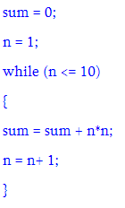
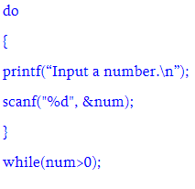
Repetition [Cont.]
Counter-controlled repetition Sentinel-controlled repetition

Slide 7
Counter-controlled repetition
Counter-controlled repetition requires:
- The name of a control variable (or loop counter).
- The initial value of the control variable.
- The increment(or decrement) by which the control variable is modified each
time through the loop.
- The condition that tests for the final value of the control variable (i.e., whether looping should continue).

Slide 8
Loop Types
There are three repetition or looping structures in C that lets us repeat statements over and over until certain conditions are met.
while Looping Structure
for Looping Structure
do…while Looping Structure

Slide 9
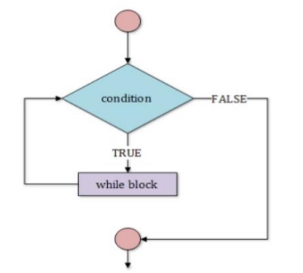
Loop Types [Cont.]
While Loop:
In while loop, a condition is evaluated before processing a body of the loop. If a condition is true then and only then the body of a loop is executed. After the body of a loop is executed then control again goes back at the beginning, and the condition is checked if it is true, the same process is executed until the condition becomes false. Once the condition becomes false, the control goes out of the loop.
In while loop, if the condition is not true, then the body of a loop will not be executed, not even once.

Slide 10
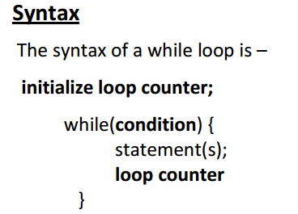
Loop Types [Cont.]

Slide 11
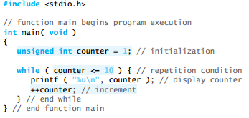
Loop Types [Cont.] Example:

Slide 12
#include <stdio.h>
int main()
{
int i =1; int sum; int num;
while (i<=5){
scanf("%d" , &num);
sum += num;
++i;}
printf("average is %d", sum/5);
return 0;
}

Slide 13
Output is doesnot run since int is used in while
#include <stdio.h>
int main()
{
while (int i <= 5)
{
printf("%d\n", i);
++i;
}
return 0;
}

Slide 14
Output is 1 to 5
#include <stdio.h>
int main()
{
while (i <= 5);
{
printf("%d\n", i);
++i;
}
return 0;
}

Slide 15
Output is infinite
#include <stdio.h>
int main()
{
int i =1;
while (-1)
{
printf("%d\n", i);
++i;
}
return 0;
}

Slide 16
Output Is 1 to 5
#include <stdio.h>
int main()
{
while (++i<= 5)
{
printf("%d\n", i);
}
return 0;
}

Slide 17
Output is 1 to 6 since it is post increment
#include <stdio.h>
int main()
{
while (i++<= 5)
{
printf("%d\n", i);
}
return 0;
}

Slide 18
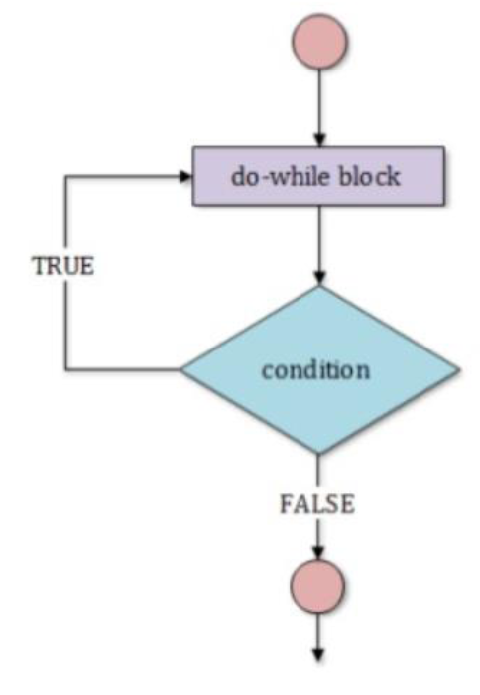
Loop Types [Cont.]
Do- while Loop:
The do while repetition statement is similar to the while statement.
The do…while repetition statement is similar to the while statement. In the while statement,the loop-continuation condition is tested at the beginning of the loop before thebody of the loop is performed. The do…while statement tests the loop-continuation condition after the loop body is performed. Therefore, the loop body will be executed at least once. When a do…while terminates, execution continues with the statement after the
while clause.It’s not necessary to use braces in the do…while statement if there’s only one statement in the body. However, the braces are usually included to avoid confusion between the while and do…while statements.

Slide 19
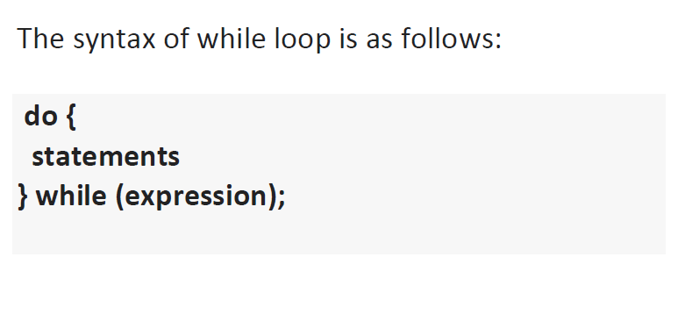
Loop Types [Cont.]

Slide 20
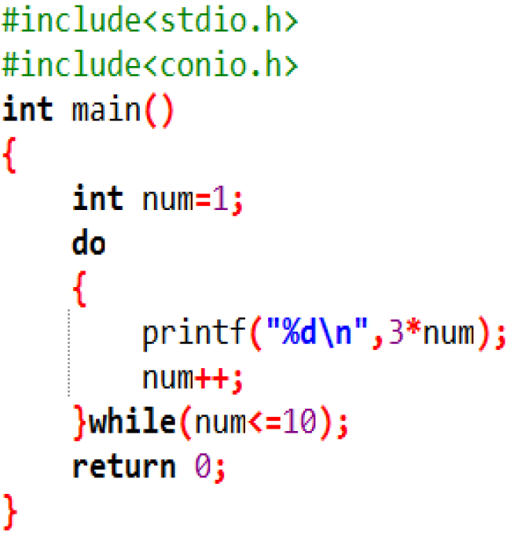
Loop Types [Cont.] Examples:
Table of 3 printed

Slide 21
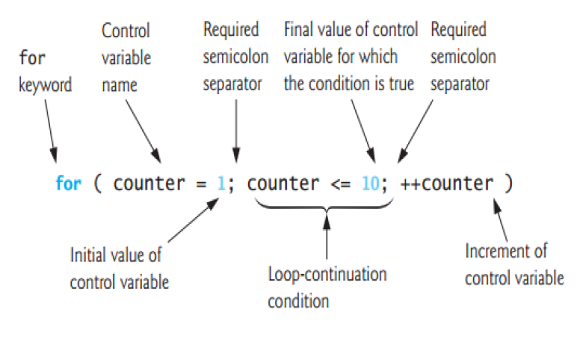
Loop Types [Cont.]
For Loop:
A for loop is a repetition control structure that allows you to efficiently write a loop that needs to execute a specific number of times.

Slide 22
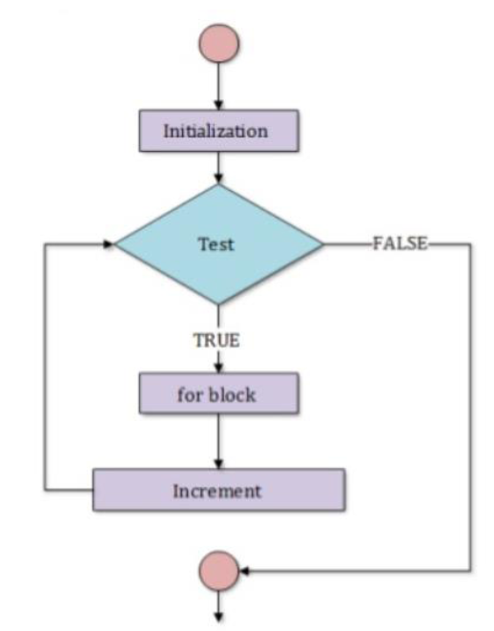
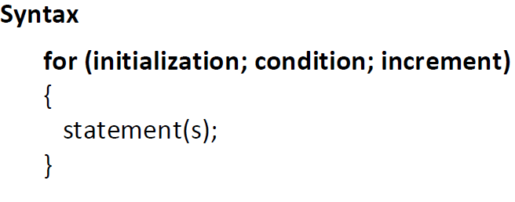
Loop Types [Cont.]
For Loop:
The for allows us to specify three things about a loop in a single line.

Slide 23
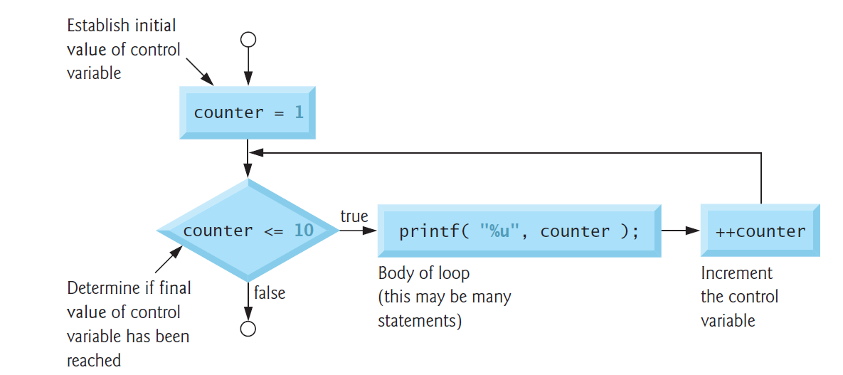
Flowcharting a typical for repetition statement

Slide 24
Loop Types [Cont.]
Here is the flow of control in a 'for' loop −
The initialization step is executed first, and only once. This step allows you to declare and initialize any loop control variables.
Next, the condition is evaluated. If it is true, the body of the loop is executed. If it is false, the body of the loop does not execute and the flow of control jumps to the next statement just after the 'for' loop.
After the body of the 'for' loop executes, the flow of control jumps back up to the increment statement. This statement allows you to update any loop control variables.
The condition is now evaluated again. If it is true, the loop executes and the process repeats itself (body of loop, then increment step, and then again condition). After the condition becomes false, the 'for' loop terminates.

Slide 25
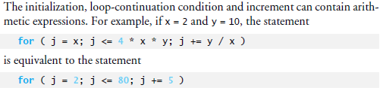
Loop Types [Cont.]

Slide 26
what is the output 11 is output
#include <stdio.h>
int main() {
int i;
for (i = 1; i < 11; ++i);
{
printf("%d ", i);
}
return 0;
}

Slide 27
what is the output doesnot run cause variable initialize in for
#include <stdio.h>
int main() {
for (int i = 1; i < 11; ++i)
{
printf("%d ", i);
}
return 0;
}

Slide 28
what is the output infinite 1
#include <stdio.h>
int main() {
int i =1;
for (;;)
{
printf("%d ", i);
}
return 0;
}

Slide 29
Loop Types [Cont.]
TASK:
Write a program to Calculate and Print Product of n odd integers. N will be inputted by user.

Slide 30
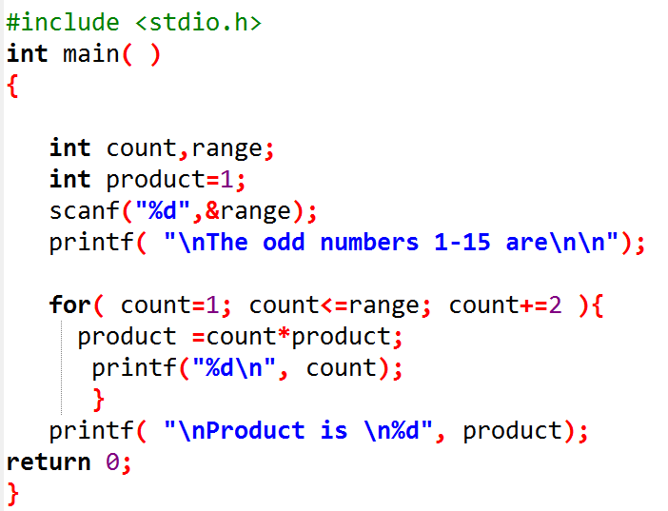
Loop Types [Cont.]

